Slide 1
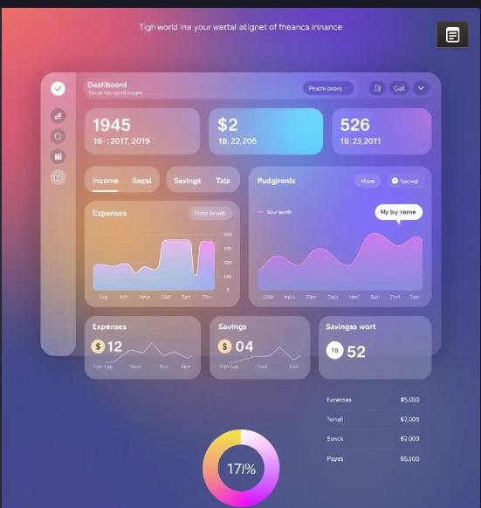
Personal Finance Manager: A Full-Stack Web Application
Track expenses, set budgets, and achieve financial goals with our powerful web application.

Slide 2

The Problem: Untracked Spending
Lack of Visibility
Difficult to know where money goes.
Budgeting Challenges
Impossible to create accurate budgets.
Missed Opportunities
Can't identify areas to save.
Financial Stress
Leads to anxiety and uncertainty.

Slide 3





Our Solution: All-In-One Web App
Transaction Input
Easy manual entry or automatic import
Interactive Dashboard
Real-time financial overview
Visual Reports
Understand spending patterns
Secure Data
Encrypted storage and authentication

Slide 4





Technology Stack: Overview
Front-End
HTML, CSS, JavaScript (Chart.js)
Back-End
PHP API
Database
MySQL
This platform uses common technology to maximize performance and accessibility across devices.

Slide 5
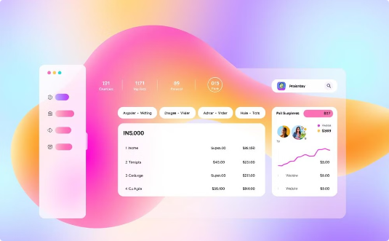
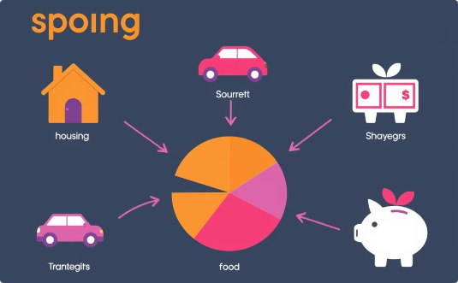
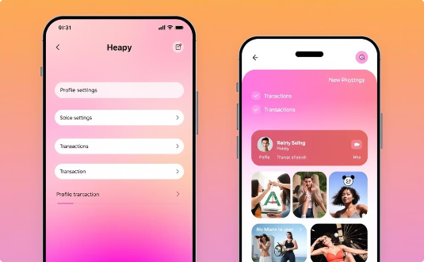
Intuitive Front-End Design
User-Friendly UI
Dynamic Charts
Customizable Settings
Simple navigation
Visualize spending trends
Tailor the app to fit your needs.

Slide 6



Secure Back-End API
User Authentication
Secure login and registration
Transaction Management
Create, read, update, delete transactions
Data Processing
Calculations for reports and dashboards

Slide 7
Database Schema: Clean and Efficient
Users
1
User ID, username, password, email
Transactions
2
Transaction ID, user ID, date, amount, category
Categories
3
Category ID, category name

Slide 8

Data Analysis: Powerful Insights
30%
$500
Savings Rate
Monthly Expenses
Track savings rate over time
Total spending per month
10%
Category Spending
Percentage spent per category

Slide 9
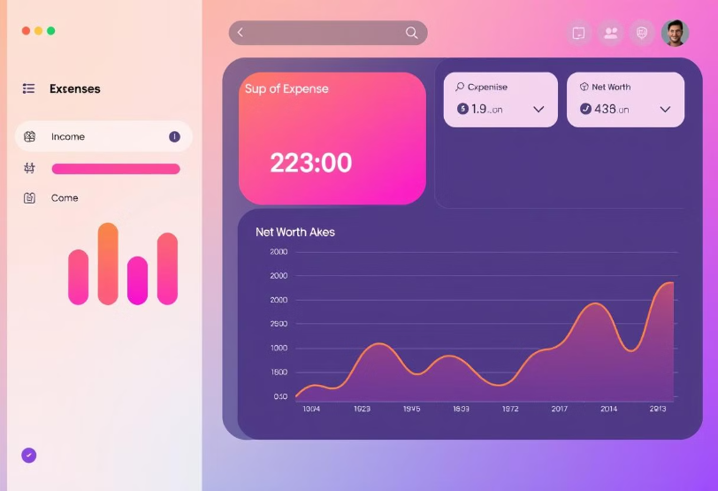
Demo: See it in Action
Adding Transactions
Quickly record income and expenses
Viewing Charts
Explore spending trends

Slide 10



Future Enhancements: AI Predictions
1
Personalized Tips
2
Automated Budgets
3
Spending Predictions
Adding intelligent features for pro-active finance management

Slide 11


